Slide 1
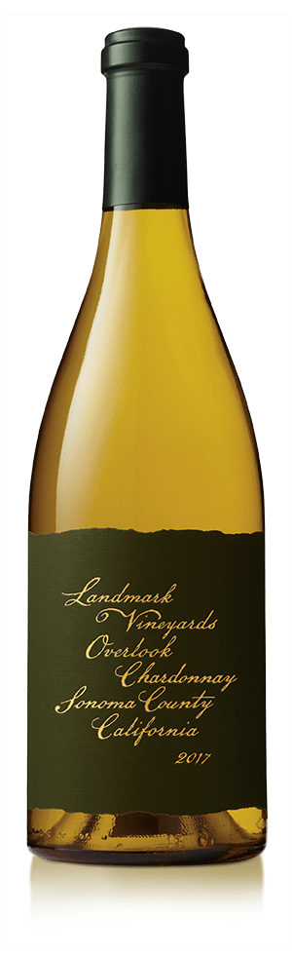
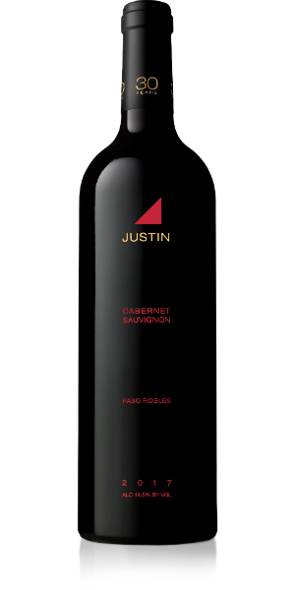
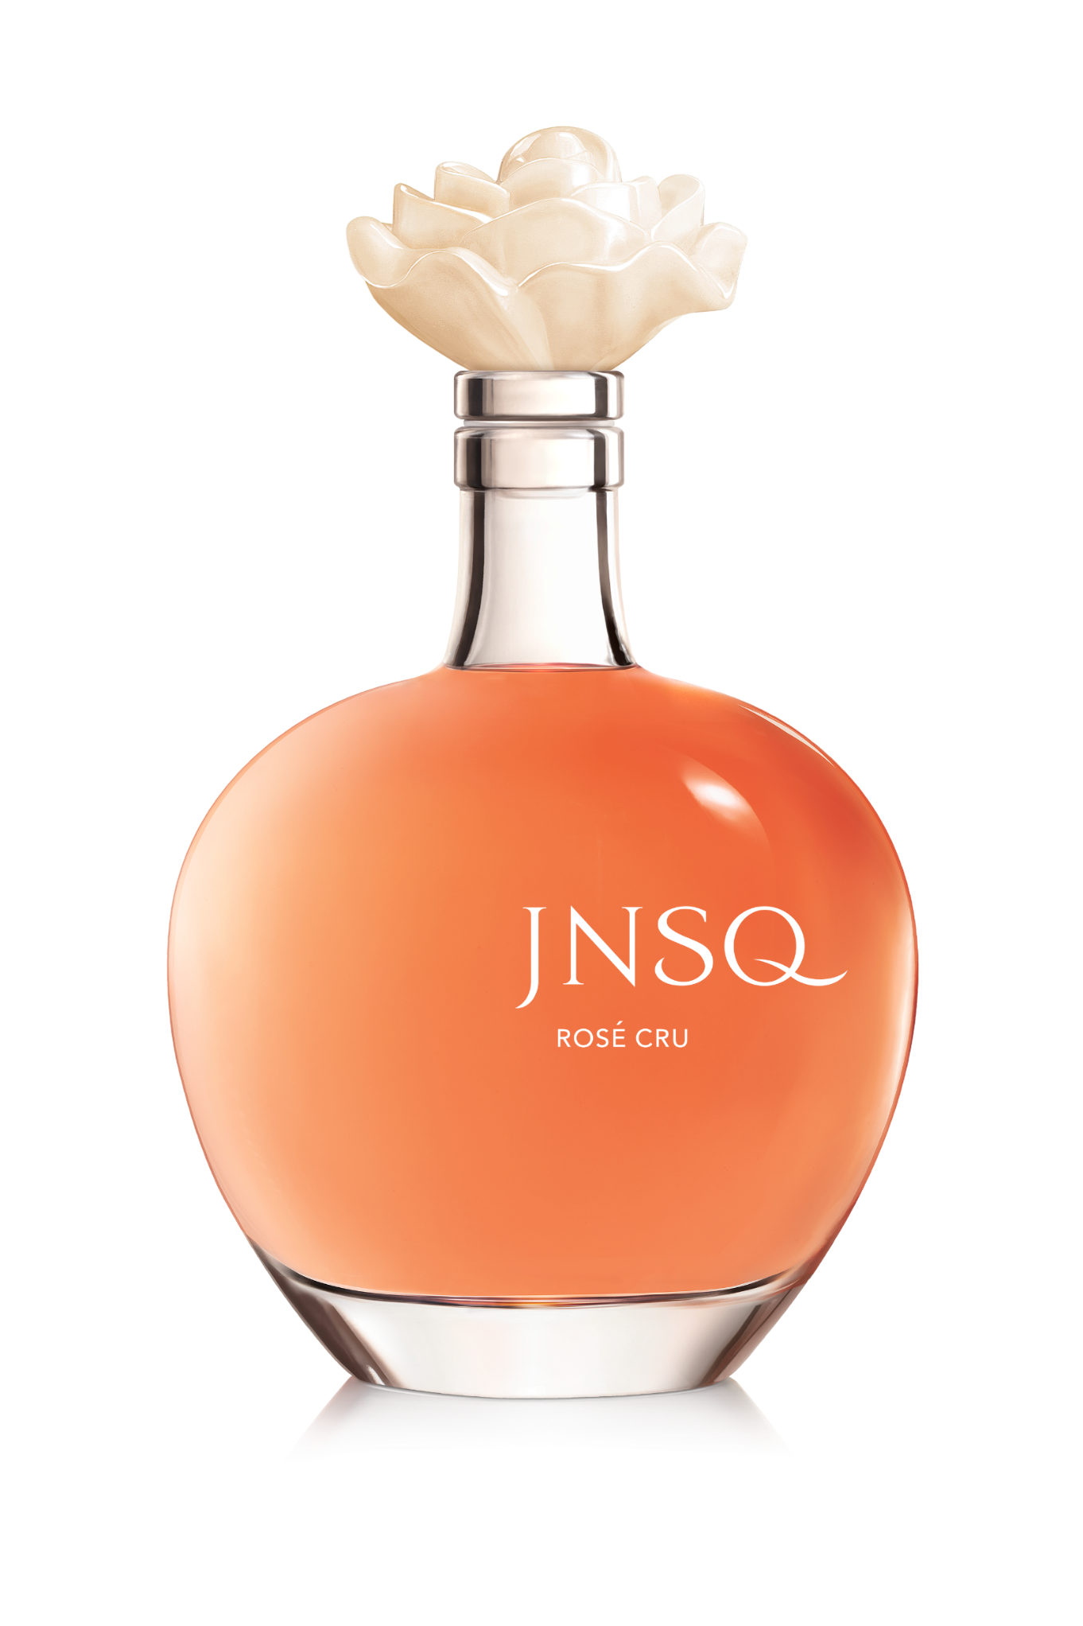


Wine Night with
Informational and networking event for first-year MBA students interested in Marketing and Strategy summer internships
November 18, 2019 | 4:30-6:30pm
11444 W. Olympic Blvd, Los Angeles, CA 90064
Join us for a tasting of the award-winning wines from The Wonderful Company’s portfolio, including JUSTIN Vineyards, Landmark Vineyards and JNSQ Wines, led by our Wine marketing team. Networking with Marketing and Strategy team members to follow. We look forward to seeing you there!
To help you get to and from the event safely, use promo code e9k0c48 for $10 off your ride.
APPLY ON MYCAREER BY NOVEMBER 11, 2019

